Slide 1

MX2020 Big Data
Data Leke Reference Architecture
Fraud Control
May 18, 2020

Slide 2
Change control
Versión | Fecha | Descripción del Cambio | Autor/Departamento
0.1 | 18/05/2020 | Creation of the document | [Big Data Architecture] Susana Edith Barrientos Galicia

Slide 3
Table of Contents
Features and terminology
Needs and Solution Proposal
Graphic Representation of the Solution
Infrastructure and Connectivity
General services
Risks and Dependencies
Standards, Patterns and Decisions of Architecture
References and Annexes

Slide 4
Features and terminology

Slide 5



Features and terminology (I)
Data Lake - Fraud Control
Data Sources
Acquisition & Ingest layer
Processing Layer
Abinitio
Raw
Curated
Augmented
Layers of Architecture of a Data Lake
Batch Layer
N... node
Functional division for the data life cycle
Hue
Hue
Sentry, Kerberos
UI Framework
SDK
Workflow
Workflow
Hive
Oozie
Scheduler
Metadata
Languages, Compilers
Fast read / write access
Flume, Sqoop
Pig / Hive
HBase
Data Integration
Components of the batch layer
HDFS
Hadoop Distributed File Systems
Job
Spark
Processing
YARN
Resources Manager
Zookeeper
Coordination
cloudera
Data Lake

Slide 6
Needs and Solution Proposal (I)
Descripción de la solución técnica
Objective
Define core components, pieces of code for the Data Lake Fraud Control project architecture
Scope
Represent graphics of the components, internal structure and integrations, incorporating the use of good design and development practices in the different phases of the software engineering process.
Description
Due to the reengineering of the Architecture of the Fraud Control area, the following functionalities for the Data Lake are identified:
Validate files (Existence and structure)
Move Row Zone data to Cured
Data quality
Process the data according to the business rules of the Fraud Control area, make a view available for the visualization tool
Create the views in Hive to be consumed by the visualization tool

Slide 7
Needs and Solution Proposal (I)
Descripción de la solución técnica
Prerequisites to the Data Lake process
Define core components, pieces of code for the Data Lake Fraud Control project architecture

Slide 8
Needs and Solution Proposal (II)
Descripción de la solución técnica - Activities
Activities and high-level estimation of the software engineering process
Define core components, pieces of code for the Data Lake Fraud Control project
Start
Data analysis (, define expected model)
Review current model
Define expected Model
Prepare, review use cases
Prepare, review test cases
Design (Internal structure of the components)
Refine Architecture
Prepare diagrams of the functional flow of each component
Define the internal structure of the component and elaborate graphic representation
Validate the Architecture's fullness
Implementation
Validate unit tests
Functional and Non-Functional Tests
Deployment in different Environments
Validate in different environments
End

Slide 9
Needs and Solution Proposal (III)
Descripción de la solución técnica - Product baseline
PRODUCT REQUIREMENT NUMBER | RELATED REQ ID | PRODUCT REQUIREMENT BRIEF DESCRIPTION | PRODUCT REQUIREMENT DESCRIPTION | PRODUCT TYPE | PRODUCT REQUIREMENT LIFECYCLE | COMPLEXITY DESCRIPTION | ESTIMATED SIZE (COMPLEXITY POINTS) | ESTIMATED SIZE | REE | A&D | IMP | TST | DPY | ESTIMATED EFFORT | ESTIMATED EFFORT
1 | DESING-001 | PROD-PROC-001 | Revisar el modelo lógico y físico actual (AS-IS) y el esperado (TO-BE) de la base de datos de Fraud Control | PROCESS | DEVELOPMENT | SIMPLE | 12.07 | 12.07 | 1.267 | 3.380 | 12.673 | 2.746 | 1.056 | 21.12 | 21.12
2 | FUNCTIONALITY-001 | PROD-PROC-003 | Analizar, deseñar, constuir, probar y desplegar el componente ValidateEngine existencia y estructura de los archivos del Proyecto Fraud Control * | PROCESS | DEVELOPMENT | MEDIUM | 27.13 | 27.13 | 2.849 | 7.599 | 28.494 | 6.174 | 2.375 | 47.49 | 47.49
3 | FUNCTIONALITY-001 | PROD-PROC-003 | Analizar, deseñar, constuir, probar y desplegar el componente ProcesEngine existencia y estructura de los archivos del Proyecto Fraud Control | PROCESS | DEVELOPMENT | COMPLEX | 47.04 | 47.04 | 4.941 | 13.175 | 49.406 | 10.705 | 4.117 | 82.34 | 82.34
4 | FUNCTIONALITY-002 | PROD-PROC-004 | Analizar, deseñar, constuir, probar y desplegar el componente CleanEngine para cubrir la funcionalidad de limpieza de datos (split pipe |) de cada uno de los archivos del Proyecto Fraud | PROCESS | DEVELOPMENT | MEDIUM | 27.13 | 27.13 | 2.849 | 7.599 | 28.494 | 6.174 | 2.375 | 47.49 | 47.49
5 | FUNCTIONALITY-003 | PROD-PROC-005 | Analizar, deseñar, constuir, probar y desplegar el componente DataQuality para satisfacer la funcionalidad de integridad del dato | PROCESS | DEVELOPMENT | COMPLEX | 47.04 | 47.04 | 4.941 | 13.175 | 49.406 | 10.705 | 4.117 | 82.34 | 82.34
6 | FUNCTIONALITY-003 | PROD-PROC-006 | Analizar, deseñar, constuir, probar y desplegar el componente de DataQuality para satisfacer la funcionalidad no duplicidad del dato | PROCESS | DEVELOPMENT | COMPLEX | 47.04 | 47.04 | 4.941 | 13.175 | 49.406 | 10.705 | 4.117 | 82.34 | 82.34
7 | FUNCTIONALITY-003 | PROD-PROC-007 | Analizar, deseñar, constuir, probar y desplegar el componente de DataQuality para satisfacer la funcionalidad seguridad del dato | PROCESS | DEVELOPMENT | COMPLEX | 47.04 | 47.04 | 4.941 | 13.175 | 49.406 | 10.705 | 4.117 | 82.34 | 82.34
8 | FUNCTIONALITY-004 | PROD-PROC-007 | Analizar, deseñar, constuir, probar y desplegar el componente de CommandHadoop para satisfacer la funcionalidad de mover los datos a la zona Curada | PROCESS | DEVELOPMENT | MEDIUM | 27.13 | 27.13 | 2.849 | 7.599 | 28.494 | 6.174 | 2.375 | 47.49 | 47.49
9 | FUNCTIONALITY-005 | PROD-PROC-008 | Analizar, deseñar, constuir, probar y desplegar el componente de processEngine para satisfacer la funcionalidad elaborar reporte de Monitoreo | PROCESS | DEVELOPMENT | MEDIUM | 27.13 | 27.13 | 2.849 | 7.599 | 28.494 | 6.174 | 2.375 | 47.49 | 47.49
10 | FUNCTIONALITY-005 | PROD-PROC-009 | Analizar, deseñar, constuir, probar y desplegar el componente de processEngine para satisfacer la funcionalidad elaborar reporte Posdictamen | PROCESS | DEVELOPMENT | MEDIUM | 27.13 | 27.13 | 2.849 | 7.599 | 28.494 | 6.174 | 2.375 | 47.49 | 47.49
11 | FUNCTIONALITY-005 | PROD-PROC-010 | Analizar, deseñar, constuir, probar y desplegar el componente de processEngine para satisfacer la funcionalidad elaborar reporte Casos Sospechosos | PROCESS | DEVELOPMENT | MEDIUM | 27.13 | 27.13 | 2.849 | 7.599 | 28.494 | 6.174 | 2.375 | 47.49 | 47.49
12 | FUNCTIONALITY-005 | PROD-PROC-011 | Analizar, deseñar, constuir, probar y desplegar el componente de processEngine para satisfacer la funcionalidad elaborar reporte Estádistico y resumen | PROCESS | DEVELOPMENT | MEDIUM | 27.13 | 27.13 | 2.849 | 7.599 | 28.494 | 6.174 | 2.375 | 47.49 | 47.49
13 | FUNCTIONALITY-005 | PROD-PROC-012 | Analizar, deseñar, constuir, probar y desplegar el componente de processEngine para satisfacer la funcionalidad elaborar reporte Análisis y evaluación | PROCESS | DEVELOPMENT | MEDIUM | 27.13 | 27.13 | 2.849 | 7.599 | 28.494 | 6.174 | 2.375 | 47.49 | 47.49
14 | FUNCTIONALITY-005 | PROD-PROC-013 | Analizar, deseñar, constuir, probar y desplegar el componente de processEngine para satisfacer la funcionalidad elaborar reporte Estadísticos y resumen de entrada y salida | PROCESS | DEVELOPMENT | MEDIUM | 27.13 | 27.13 | 2.849 | 7.599 | 28.494 | 6.174 | 2.375 | 47.49 | 47.49
* Stress testing is planned at Hbase and Impala

Slide 10
Needs and Solution Proposal (III)
Descripción de la solución técnica - Requirements baseline
Requirement Number | Requirement Id | Requirement Type | Requirement Description | Acceptance Criteria | Product Requirement Id
1 | DESING-001 | DESIGN | Se require evisar al detalle los archivos del Proyecto Fraud Control y determiner le modelo lógico y físico de las tablas que son utilizadas en cada reporte, con la finalidad tener claridad. | Revisar, elaborar el AS-IS del modelo lógico y físico de las tablas que participan en cada uno de los reports. | 1
2 | DESING-002 | DESIGN | Se require elaborar el modelo lógico y físico esperadol (TO-BE) de la base de datos de Fraud Control, incorporando buenas práticas de Hbsase y Hive o Impala | Elaborar el modelo físico y lógico de las tablas Hbase y vistas hive | 1
3 | FUNCTIONALITY-001 | FUNCTIONALITY | Validar existencia y estructura de archivos del Proyecto Fraud Control | Validar la existencia en Raw y estructura de cada uno de los archivos del Proyecto Fraud Control | 2,3
4 | FUNCTIONALITY-002 | FUNCTIONALITY | Limpiar los datos de los archivos del Proyecto Fraud Control (split pipe |) |  | 4
5 | FUNCTIONALITY-003 | FUNCTIONALITY | Comprobar la integridad de los datos de los archivos Proyecto Fraud Control | Garantizar la integridad de los datos en las distintas zonas del Data Lake | 5,6 y 7
7 | FUNCTIONALITY-004 | FUNCTIONALITY | Mover los datos de la Zona Raw a Curated | Garantizar que los datos que están en Raw sean enviados a Curated | 8
8 | FUNCTIONALITY-005 | FUNCTIONALITY | Elaborar reporte de Monitoreo | Crear la o las vistas para que sean consumidas por la herramienta de Visualización | 9
9 | FUNCTIONALITY-005 | FUNCTIONALITY | Elaborar reporte Posdictamen | Crear la o las vistas para que sean consumidas por la herramienta de Visualización | 10
10 | FUNCTIONALITY-005 | FUNCTIONALITY | Elaborar reporte Casos Sospechosos | Crear la o las vistas para que sean consumidas por la herramienta de Visualización | 11
11 | FUNCTIONALITY-005 | FUNCTIONALITY | Elaborar reporte Estádistico y resumen | Crear la o las vistas para que sean consumidas por la herramienta de Visualización | 12
12 | FUNCTIONALITY-005 | FUNCTIONALITY | Elaborar reporte Análisis y evaluación | Crear la o las vistas para que sean consumidas por la herramienta de Visualización | 13
13 | FUNCTIONALITY-005 | FUNCTIONALITY | Elaborar reporte Estadísticos y resumen de entrada y salida | Crear la o las vistas para que sean consumidas por la herramienta de Visualización | 14

Slide 11

Needs and Solution Proposal (IV)
New component
Component to modify
Data Lake - Fraud Control – Global Architecture I
Component not contemplated
General flow
Data Sources
Serving Layer
Integration with Hadoop components
Acquisition & Ingest layer
Processing Layer
A
B
Abinitio
Raw
Curated
Augmented
Abinitio ETL envía archivos del Fraud Control a la Zona Raw
The Data Lake Job validates the existence of the file and the structure of the files (at this point the dimensions of data quality must be considered)
The Data Lake process moves the data to the Curated Zone, it recommends the separation of domains in Hbase, to incorporate the data in its corresponding family.
The Data Lake process processes the data to create the Hive views that will be consumed by the visualization tool
1.
Visualization Tool
4.
Batch Layer
N... node
Hue
Hue
Sentry, Kerberos
UI Framework
SDK
Workflow
Workflow
Hive
Oozie
Scheduler
Metadata
Languages, Compilers
Fast read / write access
Flume, Sqoop
Pig / Hive
HBase
Data Integration
A
2.
HDFS
Hadoop Distributed File Systems
B
Job
Spark
Processing
3.
YARN
Resources Manager
Zookeeper
Coordination
cloudera

Slide 12
Needs and Solution Proposal (V)
Data Lake - Fraud Control – Global Architecture II
You can use Impala to query HBase tables. This capability allows convenient access to a storage system that is tuned for different kinds of workloads than the default with. Impala, however, PoC is required.
After the data is loaded into the HBase tables, they are propagated to two other service engines. The first service engine is Hive, the second is Impala.
Storage Layer
3
MapReduce job
HDFS
HBase
Serving layer
Source
Impala
Abinitio
Data Visualization Tools
1
Hive
Raw
Curated
4
The visualization tool consumes the data processed in Hive or Impala.
Abinitio carries out the ingest process, which includes the acquisition of the files, landing them in HDFS (Raw Zone).
Data is load into deferens engine
Storage Layer
2
The processing engine validates the existence of the files and their structure, performs data quality and a series of transformations to join the relevant data sets. Most of these unions are based on a primary key in the data and send to the Cured Zone.
Batch
ProcessingEngine

Slide 13
Needs and Solution Proposal (VI)
Data Lake - Fraud Control – Model Hbase Tables
The difference between Data Lake and Data Warehouse: Data Warehouse is a data warehouse architecture or data repository. While Data Lake is a technology to handle big data and prepare the repository (Big Data).
Data warehouse accepts any type of DBMS data, while Big Data accepts all types of data, including transnational data, social network data, machinery data or any DBMS data.
The data warehouse only handles structure data (relational or non-relational), but big data can handle structured, unstructured, and semi-structured data.
Big Data typically used a distributed file system to load big data in a distributed fashion, but the data warehouse doesn't have that kind of concept. From a business point of view, since big data has a lot of data, the analyzes will be very fruitful and the result will be more meaningful, which will help make the right decision for organizations. While the data warehouse mainly helps with the analysis of information.
The data warehouse means the relational database, so storing and retrieving data will be similar to a normal SQL query. And big data is not following the proper database structure, we need to use hive or spark SQL to view the data via hive specific query.
100% of the data loaded into the data warehouse is used for analytical reporting. But whatever the data loaded by Hadoop, the maximum 0.5% used in analytical reporting so far. Other data is loaded into the system, but in a non-use state.
Data Warehousing can never handle huge data (totally unstructured data). Big data (Apache Hadoop) was born to handle huge data (as long as good practices are used throughout Hadoop)
Recovery time increases simultaneously in the data store based on the volume of data. It means it will take little time for low volume data and long time for big data volume just like DBMS. But in case of big data, it will take a short period of time to get huge data (as it is specially designed to handle big data), and it will take a long time if we somehow try to load or recover small data in HDFS by using shrink of map.

Slide 14
Needs and Solution Proposal (V)
Data Lake - Fraud Control – Global Architecture III
Basis for Comparison | Data Warehouse | Data Lake
Meaning | Data Warehouse is mainly an architecture, not a technology. It extracting data from varieties SQL based data source (mainly relational database) and help for generating analytic reports. In terms of definition, data repository, which using for any analytic reports, has been generated from one process, which is nothing but the data warehouse. | Big Data is mainly a technology, which stands on volume, velocity, and variety of data. Volumes define the amount of data coming from different sources, velocity refers to the speed of data processing, and varieties refer to the number of types of data (mainly support all type of data format).
Accepted Data Source | Accepted one or more homogeneous (all sites use the same DBMS product) or heterogeneous (sites may run different DBMS product) data sources. | Accepted any kind of sources, including business transactions, social media, and information from sensor or machine specific data. It can come from a DBMS product or not.
Accepted type of formats | Handles mainly structural data (specifically relational data). | Accepted all types of formats. Structure data, relational data, and unstructured data including text documents, email, video, audio, stock ticker data.
Subject-Oriented | A data warehouse is subject oriented because it actually provides information on the specific subject (like a product, customers, suppliers, sales, revenue, etc) not on organization ongoing operation. It does not focus on ongoing operation, it mainly focuses on the analysis or displaying data which help on decision making. | Big Data is also subject-oriented, the main difference is a source of data, as big data can accept and process data from all the sources including social media, sensor or machine specific data. It also main on provide exact analysis on data specifically on subject oriented.
Time-Variant | The data collected in a data warehouse is actually identified by a particular time period. As it mainly holds historical data for an analytical report. | Big Data has a lot of approaches to identified already loaded data, a time period is one of the approaches on it. Big data mainly processing flat files, so archive with date and time will be the best approach to identify loaded data. But it has the option to work with streaming data, so it not always holding historical data.
Organize data | The data is organized to facilitate high performance analysis. This is generally accomplished through dimensional modeling that creates star schematics. Also, due to cost and performance implications, data warehouses generally cannot maintain a complete history and have to add or archive older data. | The data is organized to facilitate high performance analysis. This is generally accomplished through unstructured and structured modeling

Slide 15
Needs and Solution Proposal (VII)
Data Lake - Fraud Control – Best
Basis for Comparison | Data Warehouse | Data Lake
Storage | A data warehouse will consist of data that is extracted from transactional systems or data which consists of quantitative metrics with their attributes. The data is cleaned and transformed | In the data lake, all data is kept irrespective of the source and its structure. Data is kept in its raw form. It is only transformed when it is ready to be used.
Data Capturing | Captures structured information and organizes them in schemas as defined for data warehouse purposes | Captures all kinds of data and structures, semi-structured and unstructured in their original form from source systems.
Data Timeline | In the data warehouse development process, significant time is spent on analyzing various data sources. | Data lakes can retain all data. This includes not only the data that is in use but also data that it might use in the future. Also, data is kept for all time, to go back in time and do an analysis.
Users | The data warehouse is ideal for operational users because of being well structured, easy to use and understand. | Data lake is ideal for the users who indulge in deep analysis. Such users include data scientists who need advanced analytical tools with capabilities such as predictive modeling and statistical analysis.
Task | Data warehouses can provide insights into pre-defined questions for pre-defined data types. | Data lakes can contain all data and data types; it empowers users to access data prior the process of transformed, cleansed and structured.
Processing time | Data warehouses offer insights into pre-defined questions for pre-defined data types. So, any changes to the data warehouse needed more time. | Data lakes empower users to access data before it has been transformed y cleansed. Thus, it allows users to get to their result more quickly compares to the traditional data warehouse.

Slide 16
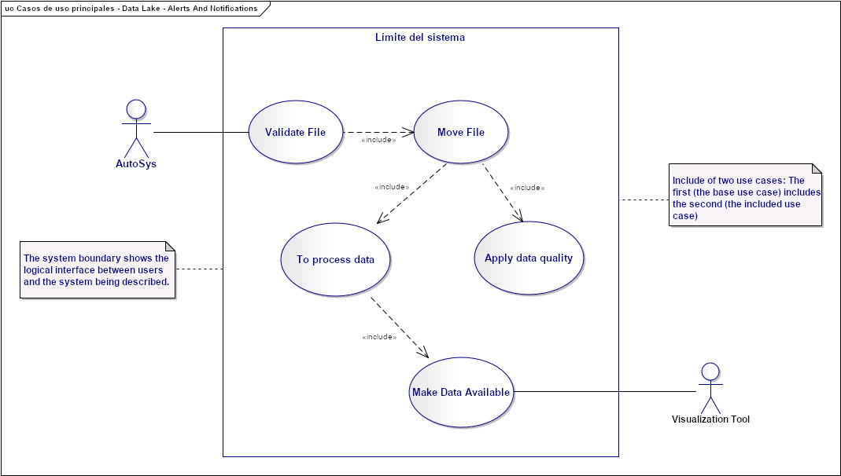
Needs and Solution Proposal (VIII)
Data Lake - Fraud Control – Use Case View
Validate File:
Move File:
Top process data:
Apply data quality:
Make Data Available
1.
2.
3.
4.
5.

Slide 17
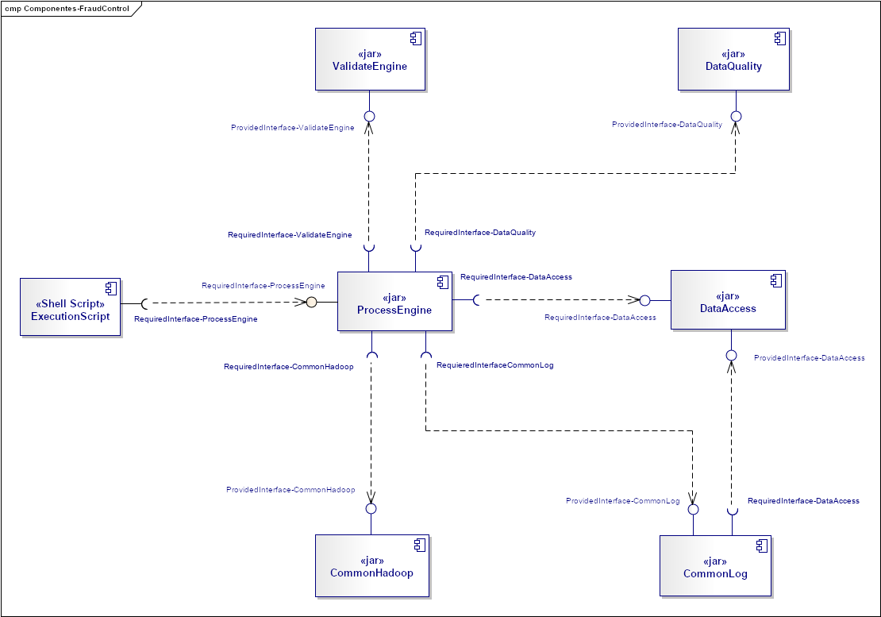
Needs and Solution Proposal (IX)
New component
Component to modify
Data Lake - Fraud Control - Component View
ProcessEngine: It is the component that is in charge of orchestrating the project flow of Fraud Control, It is contemplated that this component can handle projects with a similar casuistry (validate existence and structure files, attend to files delimited by a character, data quality, move to a curated area and create views to be consumed by visualization tools)
ValidationEnginie: It is the component that has the responsibility to perform the functionality of validating the structures of the events, it is contemplated to scale the component for validations in different projects, allowing reuse.
DataAccess: It is the component that has the responsibility to provide a common interface for access to different resources, both Hadoop and outside the Data Lake
CommandHadoop: It is the component that is responsible for providing a common interface to execute Hadoop commands
Shell-Script: It is the component that has the responsibility to execute the component "ProcessEngine”
DataQuality: It is the component that is responsible for satisfying the Data Quality requirements
CommonLog: It is the component that is responsible for monitoring the flow of customers who request it (components)
6.
2.
5.
3.
1.
4.
7.

Slide 18
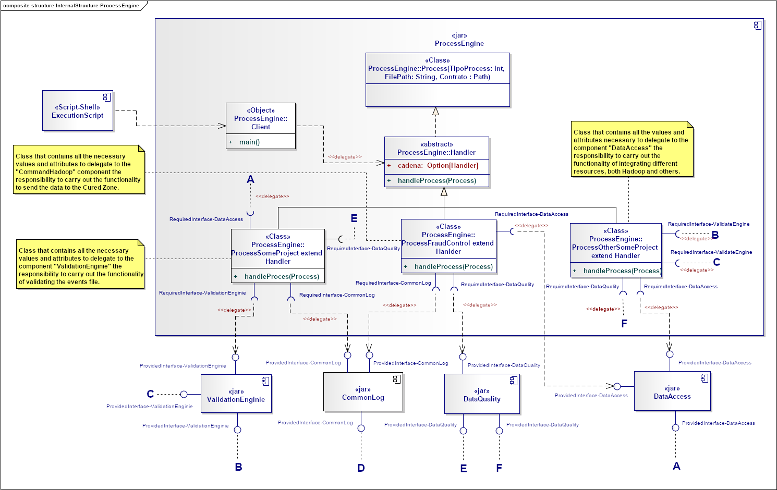
Needs and Solution Proposal (X)
New component
Component to modify
Component not contemplated
Data Lake - Fraud Control - Component View II - ProcessEngine Internal structure
Component scaling is contemplated by extending the Handler class
Component scaling is contemplated by extending the Handler class

Slide 19
Needs and Solution Proposal (XI)
Data Lake - Fraud Control - Component View II - ValidationEngine Internal structure

Slide 20
Needs and Solution Proposal (XII)
Data Lake - Fraud Control - Component View II - CommandHadoop Internal structure

Slide 21
Needs and Solution Proposal (XIII)
Data Lake - Fraud Control - Component View II - DataAccess Internal structure

Slide 22
Needs and Solution Proposal (XIV)
Data Lake - Fraud Control – Deployment view

Slide 23
Infrastructure and Connectivity

Slide 24
Infrastructure and Connectivity (I)
Resumen de Componentes de Infraestructura
Infrastructure component | Description | Applicability (New, Modified, Unmodified) | Application in which the component is located
Pendiente | Pendiente | Pendiente | Pendiente

Slide 25
Volumetría (I)
Case of use -
Characteristic | Detalle

Slide 26
Servicios Generales (I)
Seguridad
El detalle de los lineamientos mencionados están definidos en los documentos:
Standards for the creation of topics, development and security
Confidencialidad
Communication through mutual authentication and Kerberos between Data Lake
Auditoria:
Sending Logs to the Error Topic

Slide 27
Risks and Dependencies (I)
Coexistence
The detail of the mentioned guidelines are defined
Validate the integration standards with Data Lake, with Data Governance
Risks
El detalle de los lineamientos mencionados están definidos en los documentos:
Concept tests to integrate Kerberos between Data Lake

Slide 28
Risks and Dependencies (II)
Dependencias
El detalle de los lineamientos mencionados están definidos en los documentos:
Standard of Security Controls in Data Lake

Slide 29
Standards, Patterns and Decisions of Architecture (I)
Exceptions to Standards and Architecture Patterns
Pendiene

Slide 30
Standards, Patterns and Decisions of Architecture (II)
Architecture Decisions
Decisión | Premisas | Razonamiento de la Decisión
Pendienyte | Pendiente | Pendiente

Slide 31
Standards, Patterns and Decisions of Architecture (III)
Outbuildings
Dependencia | Componente externo a la solución que impacta | Fecha estimada en la que se requiere disponible
Not apply | Not apply | Not apply

Slide 32
References and Annex (I)
References
Nombre y version | Fecha | Comentarios | Rol/Departamento
https://docs.cloudera.com/documentation/enterprise/5-14-x/topics/impala_hbase.html | No Aplica | Cloudera Documentation | No Aplica
http://hbase.apache.org/book.html#datamodel | No Aplica | Cloudera Documentation | No Aplica
https://www.educba.com/big-data-vs-data-warehouse/

